Slide 1
Predicting Chemical Dependencies
Alcohol, Cannabis, and Opioids
July 2023
Elizabeth Silvius
liz.silvius@decisionq.com
2200 Wilson Boulevard, Suite 850
Arlington, Virginia
United States

Slide 2
Who We Are
FASTERANALYTICS^{T}DEVELOPED
SUBSTANCE USE DISORDER CDST CREATED
COLON CANCER RECURRENCE AND SURVIVAL CDST CREATED
INVITED TO JOIN SURGICAL CRITICAL CARE INITIATIVE
PATHFxTM CDST CREATED
1996
2008
2011
2014
2017
2017
2018
2021
2022
PATHFxTM CDST WINS SWEDEN’S SVEA PRIZE
NIH DEPLOYS PATHFxTM CDST INTO EHR
API-ACCESSIBLE ARCHITECTURE FOR MULTIPLE CDSTs CREATED
CD/SUD CDST FROM ARKANSAS ALL-PAYERS CLAIMS DATABASE

Slide 3
Predicting Chemical Dependencies
Data Gathering and Curation
Modeling
Validation

Slide 4
Data Preparation and Curation Steps
Identify unique patients over 3-year time period
Gather general patient info (e.g., age, race, location, employment, etc.)
Gather information on claims for inpatient, outpatient, pharmacy claims, and dental claims in each year
Gather diagnosis code information for each year
Gather chemical dependency diagnosis information (inpatient/outpatient)
Enhance data with outside sources

Slide 5
Data Preparation and Curation Challenges
There are two main categories for the challenges we encountered:
Understanding how to use the data properly
Identification and procurement of outside sources to help standardize and increase value of data

Slide 6
Understanding How to Use the Data Properly
One major challenge is understanding the linkages across tables, carriers, and time. This challenge is continually addressed at every data users group meeting
The data group often distinguishes between tracking enrollees within carriers/payers and tracking enrollees across carriers/payers.
The challenge is that users often want to do BOTH, along with tracking enrollees over time
The data dictionary does a great job of defining variables
Kenley’s team is extremely responsive – a fantastic resource!

Slide 7
Outside Data Sources
We procured the following outside data sources to allow grouping that increased the usefulness of the data for modeling
Data from Census Bureau to map FIPS numbers to whether an area is urban or not
Data from American Society of Health-System Pharmacists, Inc. (ASHP) which maps NDC codes to useful classes using the AHFS Pharmacologic-Therapeutic Classification System
Data from clinicians and open-source data to map ICD-10 codes to CCS Categories and chemical dependency groups

Slide 8
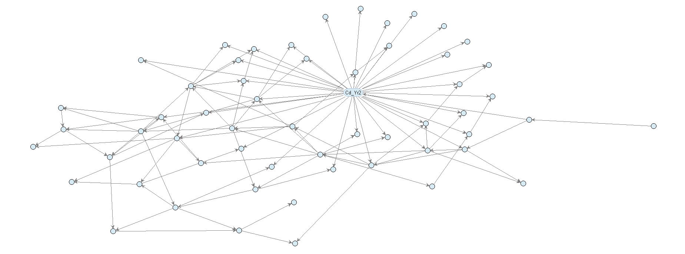
Modeling
Build Bayesian Belief Networks, which help identify conditional probabilities between variables (N = 612,518)

Slide 9
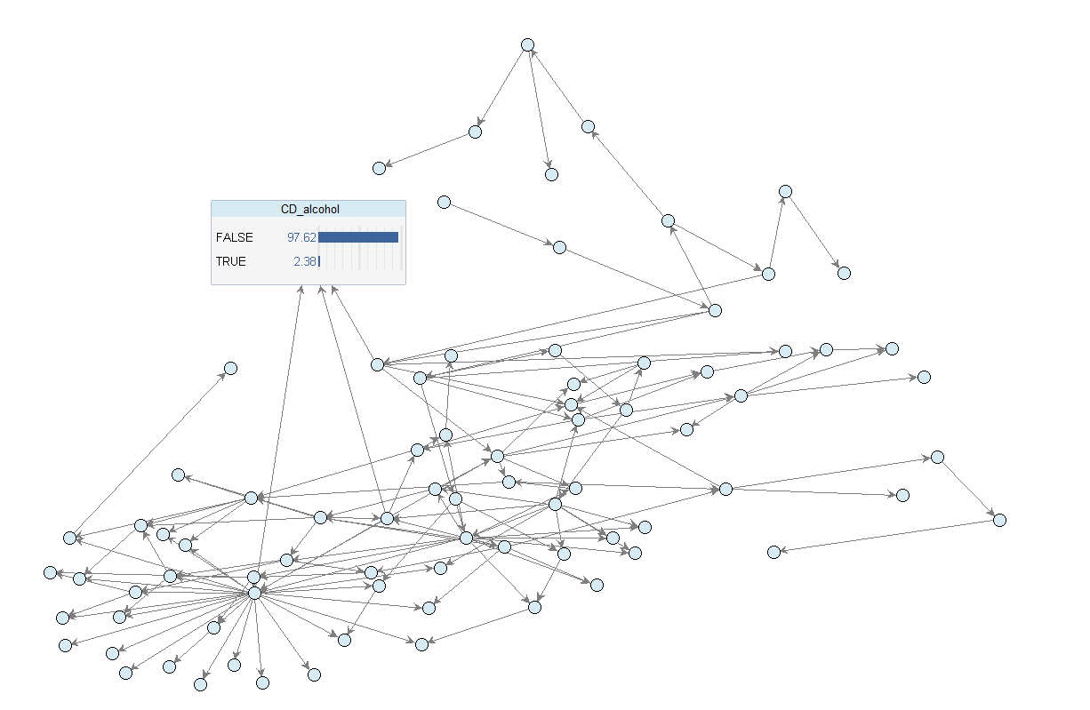
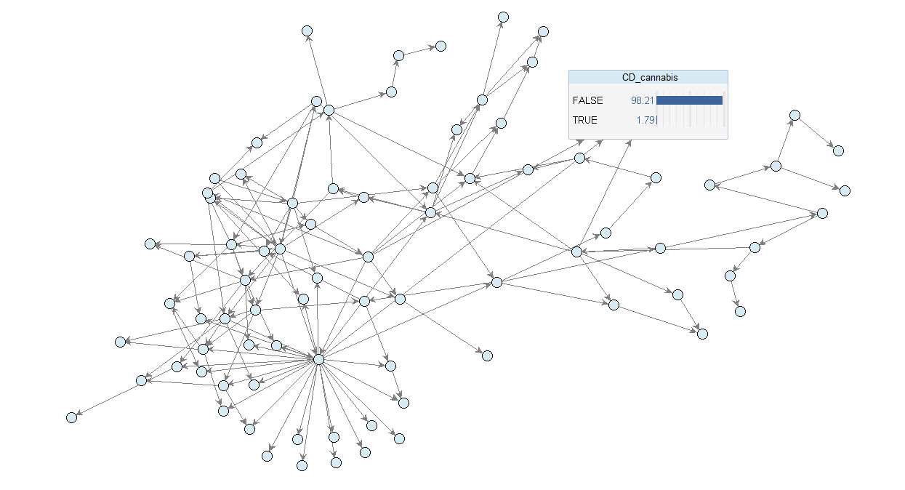
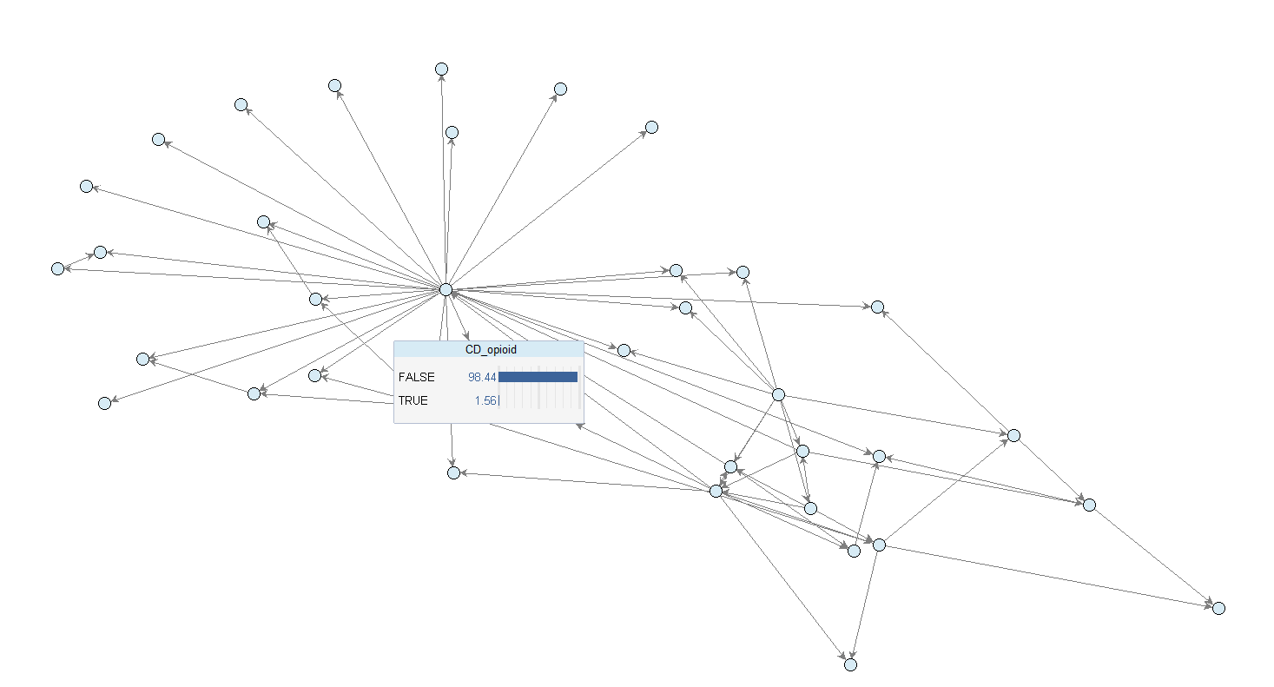
Modeling
Similar models for individual chemicals: alcohol, cannabis, and opioids

Slide 10
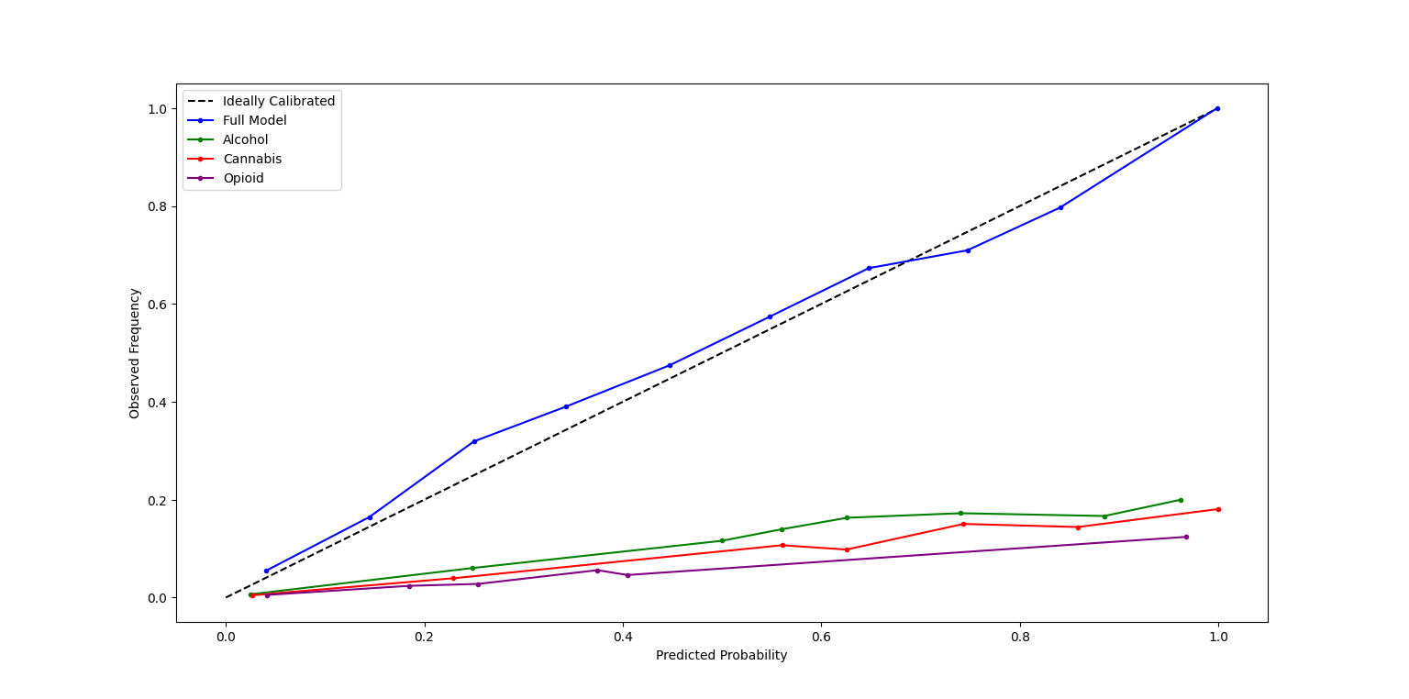
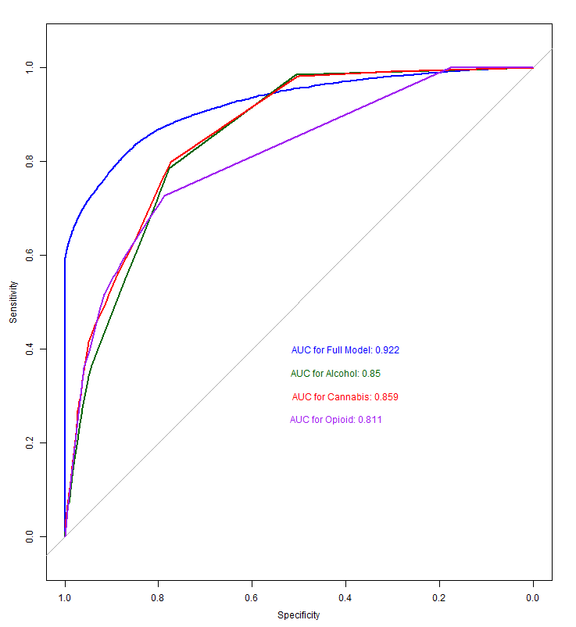
Validation
20% Holdout Set

Slide 11
Conclusion
Thank You!
Kenley Money and Trang Riley – always helpful and readily available!

